Slide 1


K J Somaiya College of Engineering, Mumbai-77
(Constituent college of Somaiya Vidyavihar University)
Operational Amplifiers
Presented by:
Prof. Seema Talmale

Slide 2
Operational Amplifiers

Slide 3
Outline of Presentation
What is an Op-Amp?
Characteristics of Ideal and Real Op-Amps
Common Op-Amp Circuits
Applications of Op-Amps
References

Slide 4
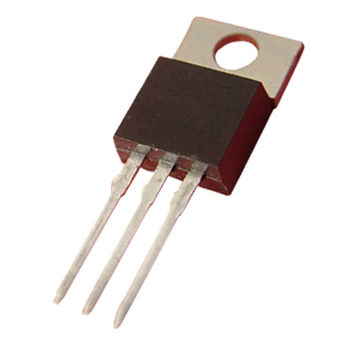
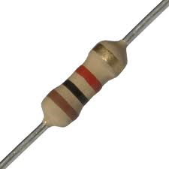
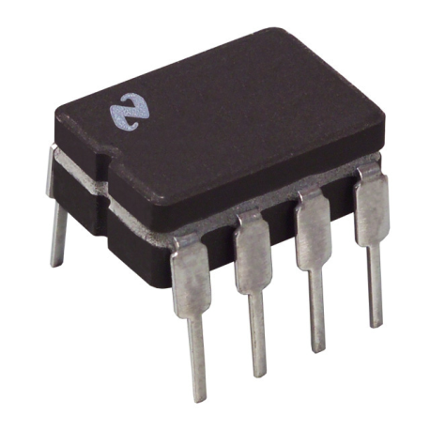
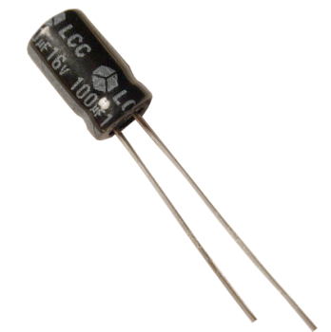
What is an Op-Amp?
An Operational Amplifier (known as an “Op-Amp”) is a device that is used to amplify a signal using an external power source
Op-Amps are generally composed of:
Transistors, Resistors, Capacitors
= + +

Slide 5
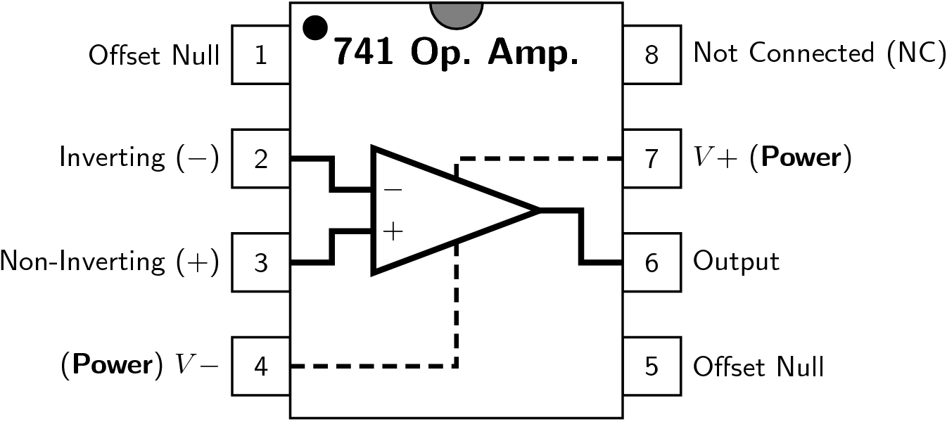
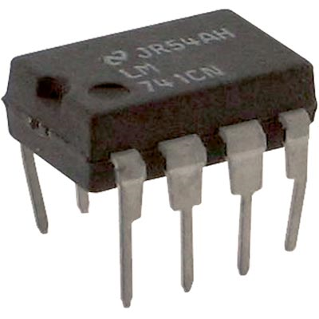
Leading to the advent of the modern IC which is still used even today (1967 – present)
Fairchild μA741
Electrical Schematic of μA741

Slide 6
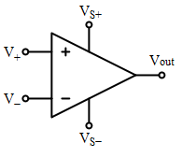
Op-Amps and their Math
A traditional Op-Amp:
V₊
V₋
V_{out}
V_{s+}
V_{s-}
: non-inverting input
: inverting input
: output
: positive power supply
: negative power supply
V_{out} = K (V₊ - V₋)
The difference between the two inputs voltages (V₊ and V₋) multiplied by the gain (K, “amplification factor”) of the Op-Amp gives you the output voltage
The output voltage can only be as high as the difference between the power supply (V_{s+} / V_{s-})and ground (0 Volts)

Slide 7
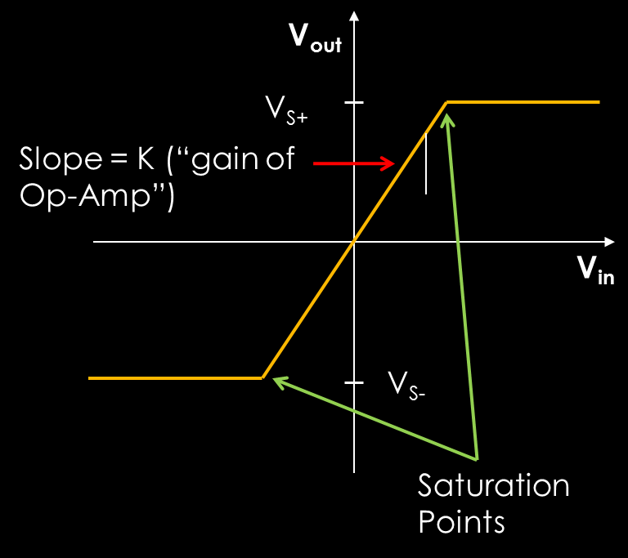
Saturation
Saturation is caused by increasing/decreasing the input voltage to cause the output voltage to equal the power supply’s voltage*
The slope is normally much steeper than it is shown here. Potentially just a few milli-volts (mV) of change in the difference between V₊ and V₋ could cause the op-amp to reach the saturation level
* Note that saturation level of traditional Op-Amp is 80% of supply voltage with exception of CMOS op-amp which has a saturation at the power supply’s voltage

Slide 8
Outline of Presentation
What is an Op-Amp?
Characteristics of Ideal and Real Op-Amps
Common Op-Amp Circuits
Applications of Op-Amps
References

Slide 9
An Ideal Op-Amp Characteristics
Infinite voltage gain
Infinite input impedance
Zero output impedance
Infinite bandwidth
Zero input offset voltage (i.e., exactly zero out if zero in).
Slew Rate(SR):The slew rate of an op amp or any amplifier circuit is the rate of change in the output voltage caused by a step change on the input. It is measured as a voltage change in a given time - typically V / µs or V / ms. A typical general purpose device may have a slew rate of 10 V / microsecond.

Slide 10
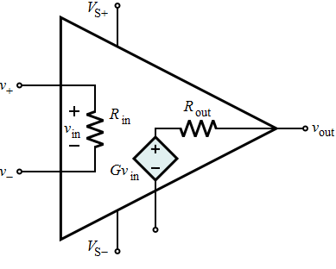
Ideal versus Real Op-Amps
Parameter | Ideal Op-Amp | Real Op-Amp
Differential Voltage Gain | ∞ | 10⁵ - 10⁹
Gain Bandwidth Product (Hz) | ∞ | 1-20 MHz
Input Resistance (R) | ∞ | 10⁶ - 10¹² Ω
Output Resistance (R) | 0 | 100 - 1000 Ω
Ideal
Real

Slide 11
Outline of Presentation
What is an Op-Amp?
Characteristics of Ideal and Real Op-Amps
Common Op-Amp Circuits
Applications of Op-Amps
References

Slide 12
Basic Op-Amp Circuits
An op-amp amplifies the difference of the inputs V₊ and V₋ (known as the differential input voltage)
This is the equation for an open loop gain amplifier:
V_{out} = K(V₊-V₋)
K is typically very large – at around 10,000 or more for IC Op-Amps
This equation is the basis for all the types of amps we will be discussing

Slide 13
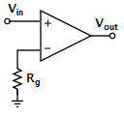
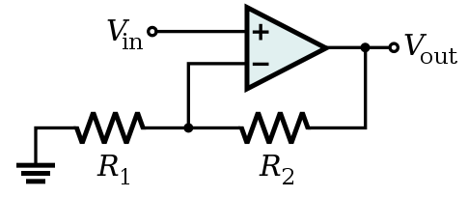
Open Loop vs Closed Loop Circuit
A closed loop op-amp has feedback from the output to the input, an open loop op-amp does not
Open Loop
Closed Loop

Slide 14
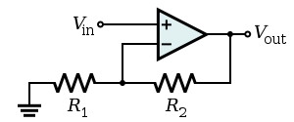
Op-Amp as Non-Inverting Amplifier
Amplifies the input voltage by a constant
Closed loop op-amp
Voltage input connected to non-inverting input
Voltage output connected to inverting input through a feedback resistor
Inverting input is also connected to ground
Non-inverting input is only determined by voltage output

Slide 15
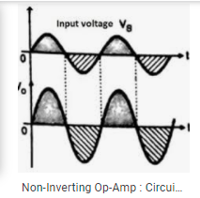
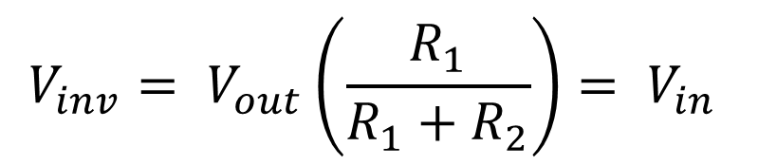
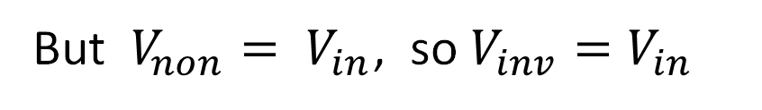

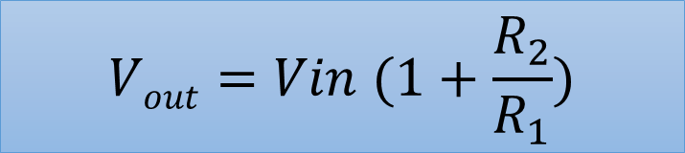
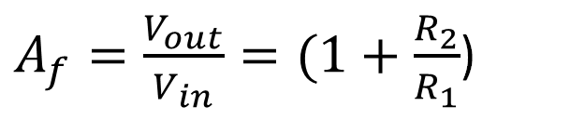
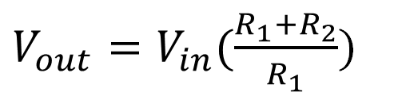
Op-Amp as Non-Inverting Amplifier
$$V_{non}=V_{inv}$$
But $V_{non}= V_{in}$, so $V_{inv}=V_{in}$
$$V_{inv}= V_{out}\left(\frac{R_{1}}{R_{1}+R_{2}}\right)= V_{in}$$
$V_{out}=V_{in}(\frac{R_{1}+R_{2}}{R_{1}}$)
$A_{f}=\frac{V_{out}}{V_{in}}=(1+\frac{R_{2}}{R_{1}}$)
$$Vout=Vin (1+\frac{R_{2}}{R_{1}})$$

Slide 16
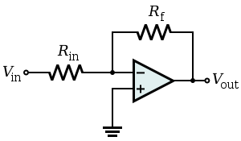
Op-Amp as Inverting Amplifier
Amplifies and inverts the input voltage
Closed loop op-amp
Non-inverting input is determined by both voltage input and output
The polarity of the output voltage is opposite to that of the input voltage
Input Voltage is connected to inverting terminal
Output Voltage is fedback to inverting input through a feedback resistor
Non-inverting input is grounded

Slide 17
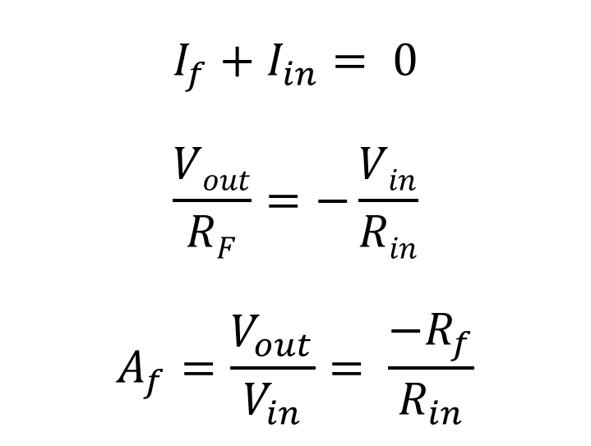
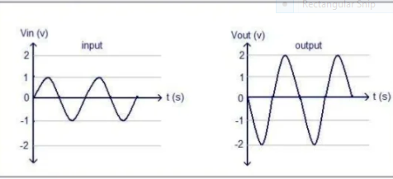
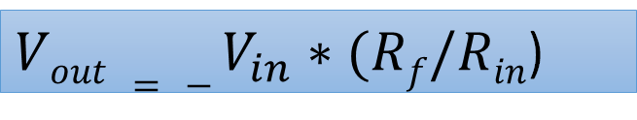
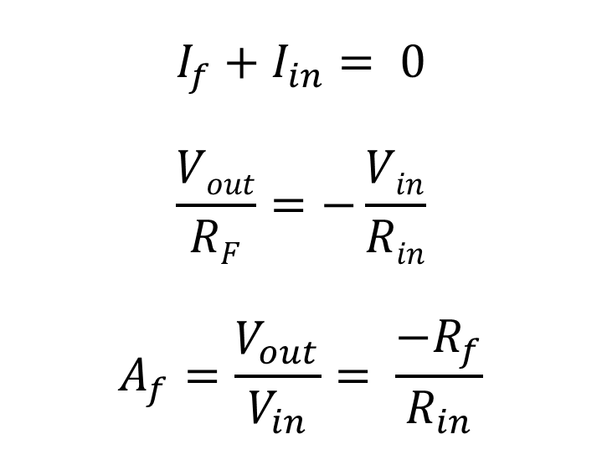
Op-Amp as Inverting Amplifier
Apply KCL at inverting node of OPAMP
$$I_{f}+I_{in}= 0$$
$$\frac{Vout}{RF}=−\frac{Vin}{Rin}$$
$$A_{f}=\frac{V_{out}}{V_{in}}= \frac{{−R}_{f}}{R_{in}}$$
$Vout = − V_{in}∗(Rf/Rin$)

Slide 18
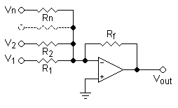
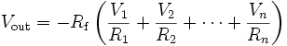
Op-Amp as Adder/Summing Amplifier

Slide 19
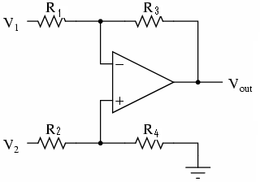
Op-Amp as Subtractor
If all resistors are equal:

Slide 20
References
Op-amps and Linear Integrated Circuits
By Ramakant A Gaikwad
Publication: Pearson Education
Linear Integrated Circuits
By Choudhary D. Roy & Shail B. Jain
Publication: New Age International

Slide 21
Thank you

